Slide 1
CHANGE Initiative
PLANNED CHANGE- HAVELOCK’S MODEL

Slide 2
INSTITUTION PROFILE
Los Angeles county hospital
Year opened- 1933
Bed capacity- 600
Hospital type- public teaching hospital
Medical residents- 1000+
Renovation of building- 2008

Slide 3

INSTITUTIONAL CHALLENGES
Poor sanitation
Dumping of waste
Slow delivery of services
Lack of system automation
Poor communication structures
Cultural and racial disparities
Inadequate resources

Slide 4
SELECTED CHANGE MODEL
HAVELOCK’S MODEL
Year developed- 1973
Founder- Ronald Havelock
Founding model- unfreezing-change-refreezing model
Primary focus- social forces in an organization

Slide 5
PHASES OF HAVELOCK’S MODEL
Build a relationship- identification of the underlying problem
Diagnosing the problem- contemplation on the need for change
Acquiring resources- gathering the human and financial resource needed
Select solution pathway- determined by the available resources
Establish and accept change- reduce resistance of the new changes
Maintenance and separation- stabilization of change and ensure it is normalized

Slide 6
EVALUATION METHODS
Establishment of company vision to meet future needs
Executing a SWOT analysis- evaluates the internal and external factors that can influence the change map
Estimate probability of success
Identify people’s factor- assessing the skills within the organization that can help with the change
Setting clear timelines- helps in the delegation of duties and simplifying of processes

Slide 7
CHANGE INITIATIVE APPROACH
Change definition and streamlining it with organization goals
Determination of impacts on the affected departments and individuals
Developing an efficient communication strategy
Training of the selected individuals and teams
Creation of a support structure
Evaluation of the change process

Slide 8
QUALITIES OF CHANGE AGENTS
Keen listeners- helps in understanding the objectives
Time-keepers- adhere to set timelines
Flexibility- ability to adapt to change faster
Diversified knowledge- will help in solving external problems
Proof of prior results- based on previous projects
Responsibility- it will enhance accountability during the evaluation stage

Slide 9

COMMUNICATION STRATEGIES
Keep the message simple
Be clear and concise
Be honest in the discussions
Outline the expectations of the model clearly
Keep open communication to foster teamwork
Tell members what they need to do
Tell members the benefits of the change
Provide incentives for fostering discipline

Slide 10
GATHERING STAKEHOLDERS
Identification of diverse stakeholder groups
Identification of stakeholder representatives
Detail individual gains of the stakeholders
Create a system to ask for stakeholder feedback
Incorporation of stakeholder feedback into the plan
Report back to the stakeholders

Slide 11

OVERCOMING RESISTANCE
Form gender, ethnic and culturally balanced teams
Outline the expectations clearly
Set achievable goals
Open two-way communication channels
Resolve conflicts quickly
Show dedication and passion
Empower innovation and creativity
Remain supportive and positive

Slide 12
IMPLEMENTATION STRATEGIES
Redefine existing cultural values
Convince individuals to fulfill team interests and not personal motives
Propose incentives- may include recognition programs for excelling and most flexible individuals
Exercise authority- lead by example and setting clear objectives
Recruit change champions- they will act as agents of change for the rest of the groups to emulate

Slide 13
IMPLEMENTATION STRATEGIES
establish a sense of urgency
create a guiding coalition
develop an objective vision
communicate the change vision widely
Gather support from stakeholders
Form short-term objectives
Announce gains and catalyze more change
form new approaches in organizational culture

Slide 14

CONDITIONS FOR CHANGE
Dissatisfaction with the status quo
Availability of knowledgeable and skilled people
Availability of resources
Availability of time to learn
Incentives for the participants
Support from the stakeholders

Slide 15
SUSTAINLE CHANGE STRATEGIES
Build continuous awareness about the change
Check for motivation within teams and departments
Open feedback channels
Assess abilities of the selected individuals
Continuous training of the employees
Creating opportunities in the organization

Slide 16
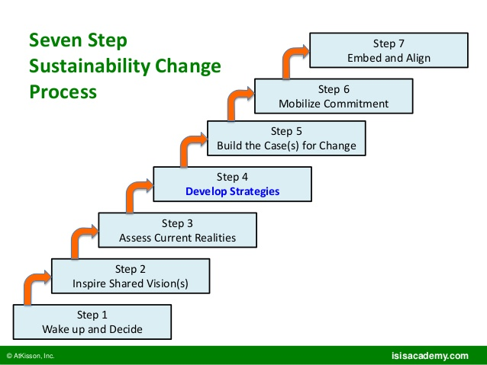
SUSTAINABLE CHANGE PROCESS

Slide 17
CONCLUSION- RELEVANCE
The model focuses on the human resource
Changing people’s behavior and notions is the main focus
It incorporates all key stakeholders in the process
The model is easy to implement and evaluate
It focuses on teamwork that fosters discipline and partnerships
Creativity and innovation is prioritized in the change model
The change is hinged on changing existing cultural values

Slide 18
REFERENCES
Bankins, S., Denness, B., Kriz, A., & Molloy, C. (2017). Innovation agents in the public sector: Applying champion and promotor theory to explore innovation in the Australian Public Service. Australian Journal of Public Administration, 76(1), 122-137.
Conger, J. (2015). Charismatic leadership. Wiley encyclopedia of management, 1-2.
Fernandez, S., & Rainey, H. G. (2017). Managing successful organizational change in the public sector. In Debating Public Administration (pp. 7-26). Routledge.
Godin, B. (2015). Models of innovation: Why models of innovation are models, or what work is being done in calling them models?. Social Studies of Science, 45(4), 570-596.
Georgalis, J., Samaratunge, R., Kimberley, N., & Lu, Y. (2015). Change process characteristics and resistance to organizational change: The role of employee perceptions of justice. Australian Journal of Management, 40(1), 89-113.

